Slide 1

PROFİLE WEİGHT CALCULATIONS USING AES ENCRYPTION
FAİK DORUK AKGÜNEY
202371202

Slide 2
CONTENTS
INTRODUCTION
PROJECT DETAILS
LITERATURE REVIEW
PROJECT PLAN
APPLICATION INTERFACE
TECHNOLOGIES USED
CRYPTOGRAPHIC PROPERTIES
RESULTS AND DISCUSSION
FUTURE WORK
CONCLUSION

Slide 3

INTRODUCTION
PROJECT OBJECTIVE: To securely calculate and store the weights of steel profiles using AES encryption to prevent unauthorized access and modification.

Slide 4

INTRODUCTION
IMPORTANCE: Accurate weight data is crucial for steel profile calculations. Incorrect data can lead to significant calculation errors, impacting both cost and safety. Secure data storage ensures integrity and accuracy.

Slide 5

INTRODUCTION
METHOD: Using AES encryption to securely encrypt and store user data, ensuring that only authorized users can access and modify the data.

Slide 6

PROJECT DETAILS
Objective: Securely calculate and manage steel profile weights.
User Roles:
Admin: Manages application and updates data.
User: Performs weight calculations using encrypted data.

Slide 7

LITERATURE REVIEW
AES ENCRYPTION: Symmetric encryption algorithm providing high security.

Slide 8

LITERATURE REVIEW
USE CASES: Used in securing communication channels, database security, and more.

Slide 9

LITERATURE REVIEW
ADVANTAGES OF AES: Reliability, efficiency, low computational cost.

Slide 10
PROJECT PLAN
GANTT CHART

Slide 11
APPLICATION INTERFACE
PLATFORM: Windows Desktop
IDE: Visual Studio 2022
Framework: .NET Framework 4.7.2

Slide 12
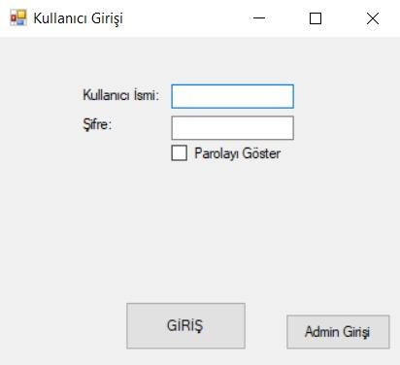
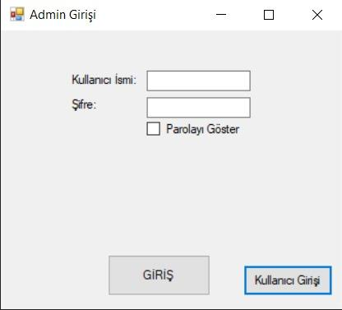
APPLICATION INTERFACE
USER LOGIN FORM

Slide 13
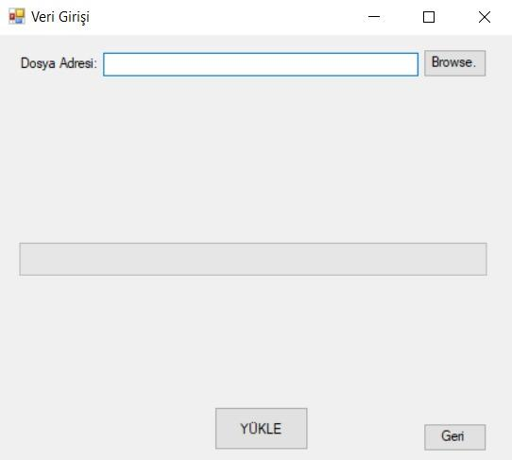
APPLICATION INTERFACE
DATA ENTRY FORM

Slide 14
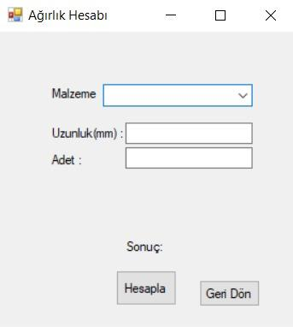
APPLICATION INTERFACE
PROFILE WEIGHT CALCULATION FORM

Slide 15
TECHNOLOGIES USED
PROGRAMMING LANGUAGE: C#
PLATFORM: .NET Framework
Framework: Windows Forms
LIBRARIES: System.Security.Cryptography

Slide 16

CRYPTOGRAPHIC PROPERTIES
ALGORITHM AND PROTOCOLS: AES (Advanced Encryption Standard)

Slide 17

CRYPTOGRAPHIC PROPERTIES
Features of AES: Symmetric encryption, same key for encryption and decryption

Slide 18

CRYPTOGRAPHIC PROPERTIES
IMPLEMENTATIONS AND LIBRARIES: System.Security.Cryptography

Slide 19
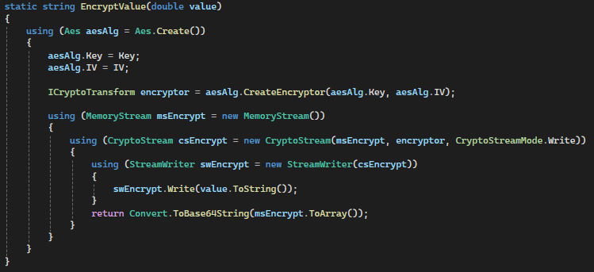
CRYPTOGRAPHIC PROPERTIES
ENCRYPTION AND DECRYPTION
ENCRYPTION

Slide 20
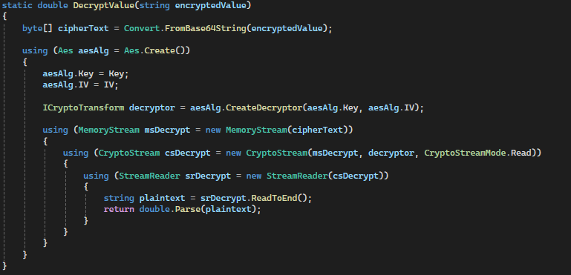
CRYPTOGRAPHIC PROPERTIES
ENCRYPTION AND DECRYPTION
DECRYPTION

Slide 21

RESULTS AND DISCUSSION
RESULTS:
Successful encryption and decryption of data
User-friendly interface
Secure storage of sensitive information

Slide 22

RESULTS AND DISCUSSION
DISCUSSION:
How AES encryption ensures data security
Ease of use and efficiency of the application

Slide 23

FUTURE WORK
Enhanced Security Features: Adding multi-factor authentication
Performance Optimization: Improving performance for larger datasets.
User Interface Improvements: Adding more features and improving user experience.
Integration with Cloud Services: Allowing secure data storage and retrieval over the internet

Slide 24
CONCLUSION
Project Goals: Secure and efficient data processing and storage achieved.
AES Encryption: Effectively ensured data security.
Future Work: Enhancing security and functionality of the application.

Slide 25
Thank You For Listening !
Do you have any questions ?

